Slide 1
«The Challenge of sharing values and ideas»
Benedetta Calonaci
European documentation Centre

Slide 2
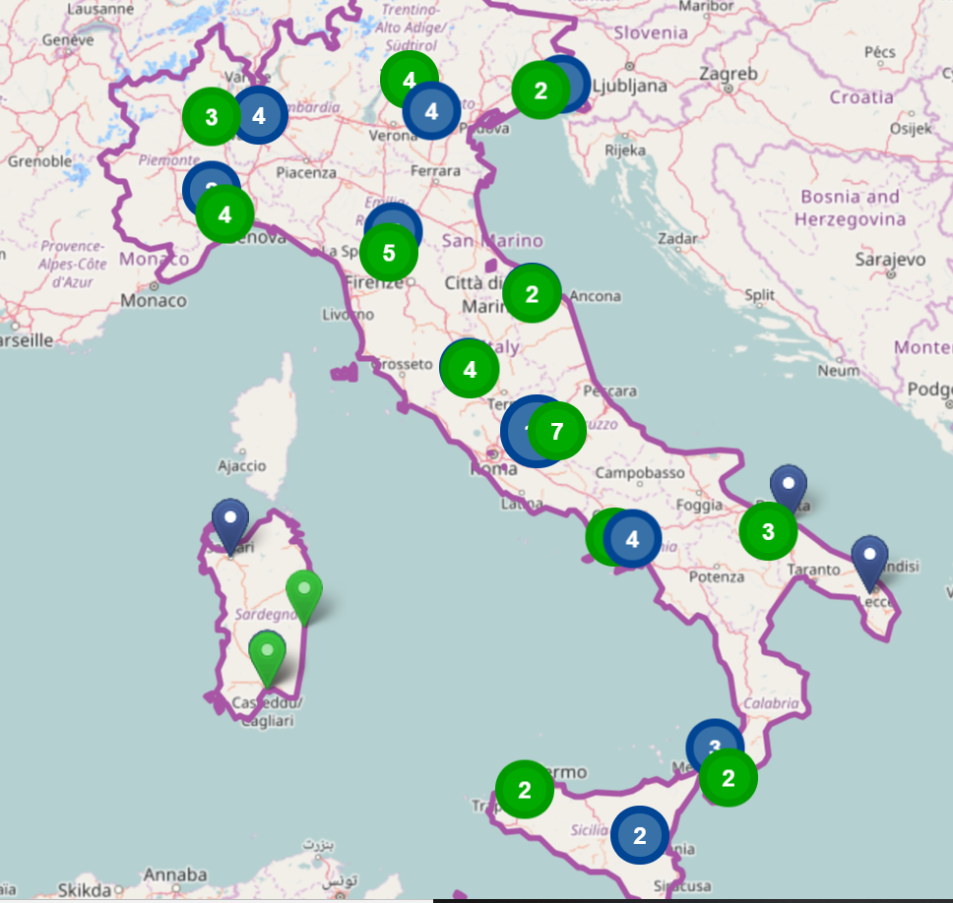
About 50 EDC in Italy - 500 in Europe

Slide 3
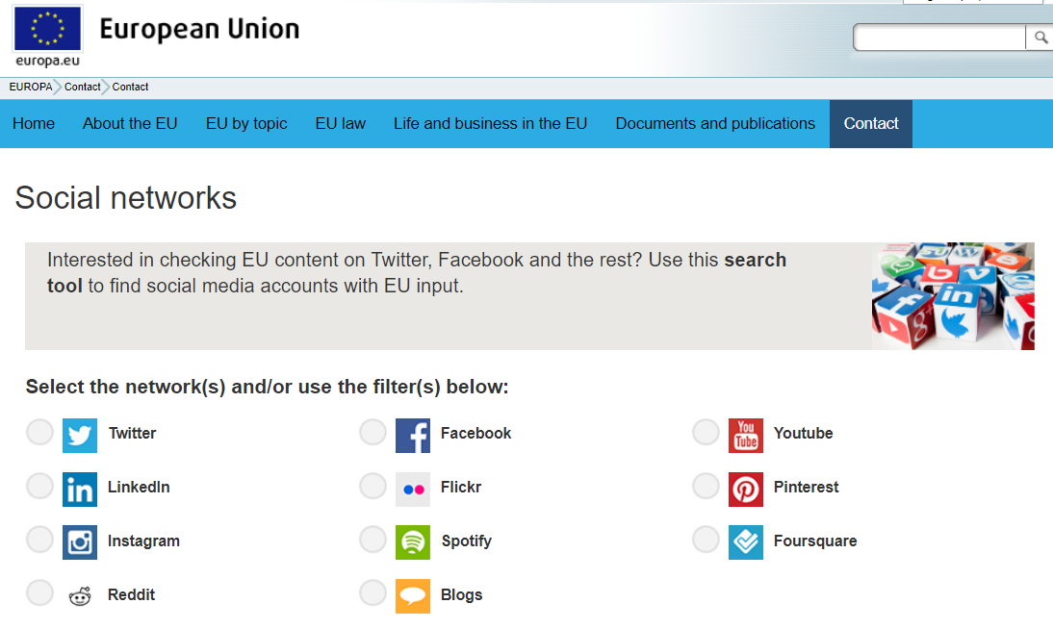

Slide 4
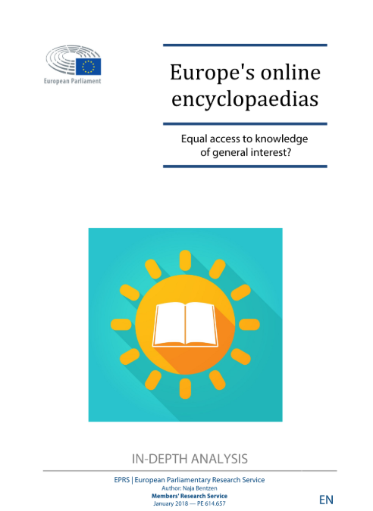

Slide 5
From the presentation: “MOOCS TO BRIDGE THE GAPS .THE POLIMI OPEN KNOWLEDGE EXPERIENCE” by DONATELLA SCIUTO

Slide 6
A«Wiki-thon» to celebrate the European year of cultural heritage 2018:

Slide 7
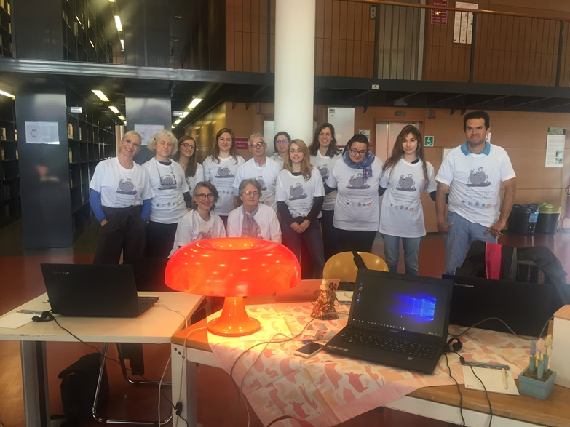
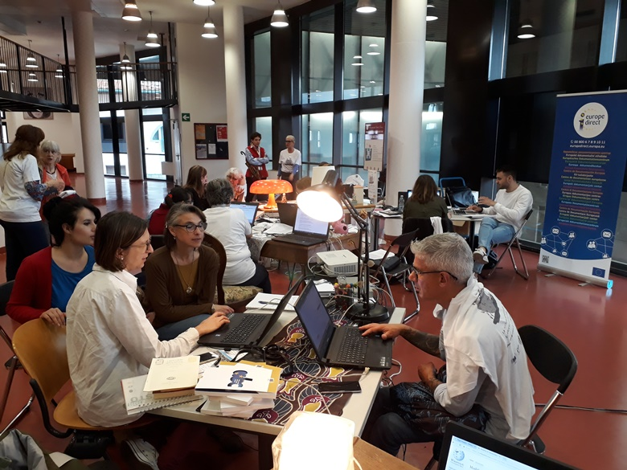
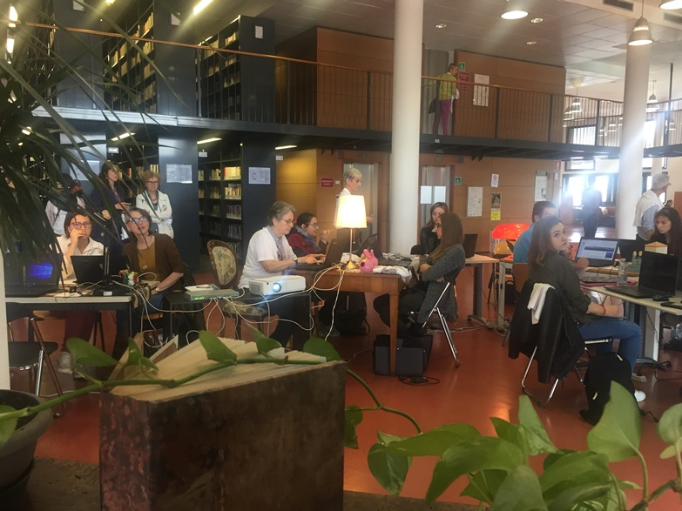

Slide 8
