Slide 1
28 Ideas from the Erasmus Generation 23 May 2019 School of Political Science “ Cesare Alfieri” and Jean Monnet Centre of Excellence University of Florence

Slide 2
The Event
Second Edition ( the first edition was organized for the 25th anniversary of the Erasmus Program)
60th Anniversary of the Rome Treaties + 30th Anniversary of the Erasmus Program
The original idea stems from a series of seminars on the “Costs of Non Europe”
Students from 28 MS discussing the current challenges to EU integration

Slide 3
Participant Selection
University partners from 28 MS in charge of selecting the participants
Two Erasmus students per MS (M+F)
Position Papers on priority issues
Travel and Accommodation Covered by the local organizers in the context of the Jean Monnet Centre of Excellence
The event was under the High Patronage of the European Parliament

Slide 4
Partner Universities
Austria: University of Salzburg3
Belgium: University of Leuven
Bulgaria: Sofia University
Czech Republic: Masaryk University
Cyprus : University of Cyprus
Denmark: University of Copenhagen
Estonia: Tallinn University of Technology
Finland: University of Helsinki
France: Sciences Politiques – Paris
Germany: Freie Universität Berlin
Greece: Athens University of Economics and Business
Hungary: Corvinus University - Budapest
Ireland: Trinity College Dublin
Latvia: University of Latvia - Faculty of Social Sciences
Lithuania: Kaunas University of Technology – Institute of Europe
Luxembourg: Université du Luxembourg
Malta: University of Malta - Institute for European Studies
Netherlands: Leiden University
Poland: University of Warsaw
Portugal: Universidade Católica Portuguesa - Lisboa
Romania: University of Bucharest
Slovakia: Comenius University in Bratislava
Slovenia: University of Ljubljana,
Spain: Universitat Autònoma de Barcelona
Sweden: University of Gothenburg
United Kingdom: University College London (UCL)

Slide 5
Outline of the Event
The 28 teams were asked to write a position paper on the issues that in their view represented a priority for revitalizing the European integration process.
In order to encourage the exchange of views among the participants, and stimulate a joint exercise, an online platform was set up for the group.
The documents prepared by the students were submitted to the local organizers by mid-April, in order to be forwarded to MEPs and other EU institutional representatives taking part in the event.

Slide 6
Outline of the Event
The final conference was scheduled during the Festival of Europe which takes place in Florence every two years and runs for a week.
First day: guided tour of Palazzo Vecchio and visit to the Historical Archives of the European Union
Second day: thematic working groups in the morning and Plenary Session in the afternoon
Third and fourth day: Interaction with the MEPs and representatives of European Institutions
2 lectures
6 different panels

Slide 7
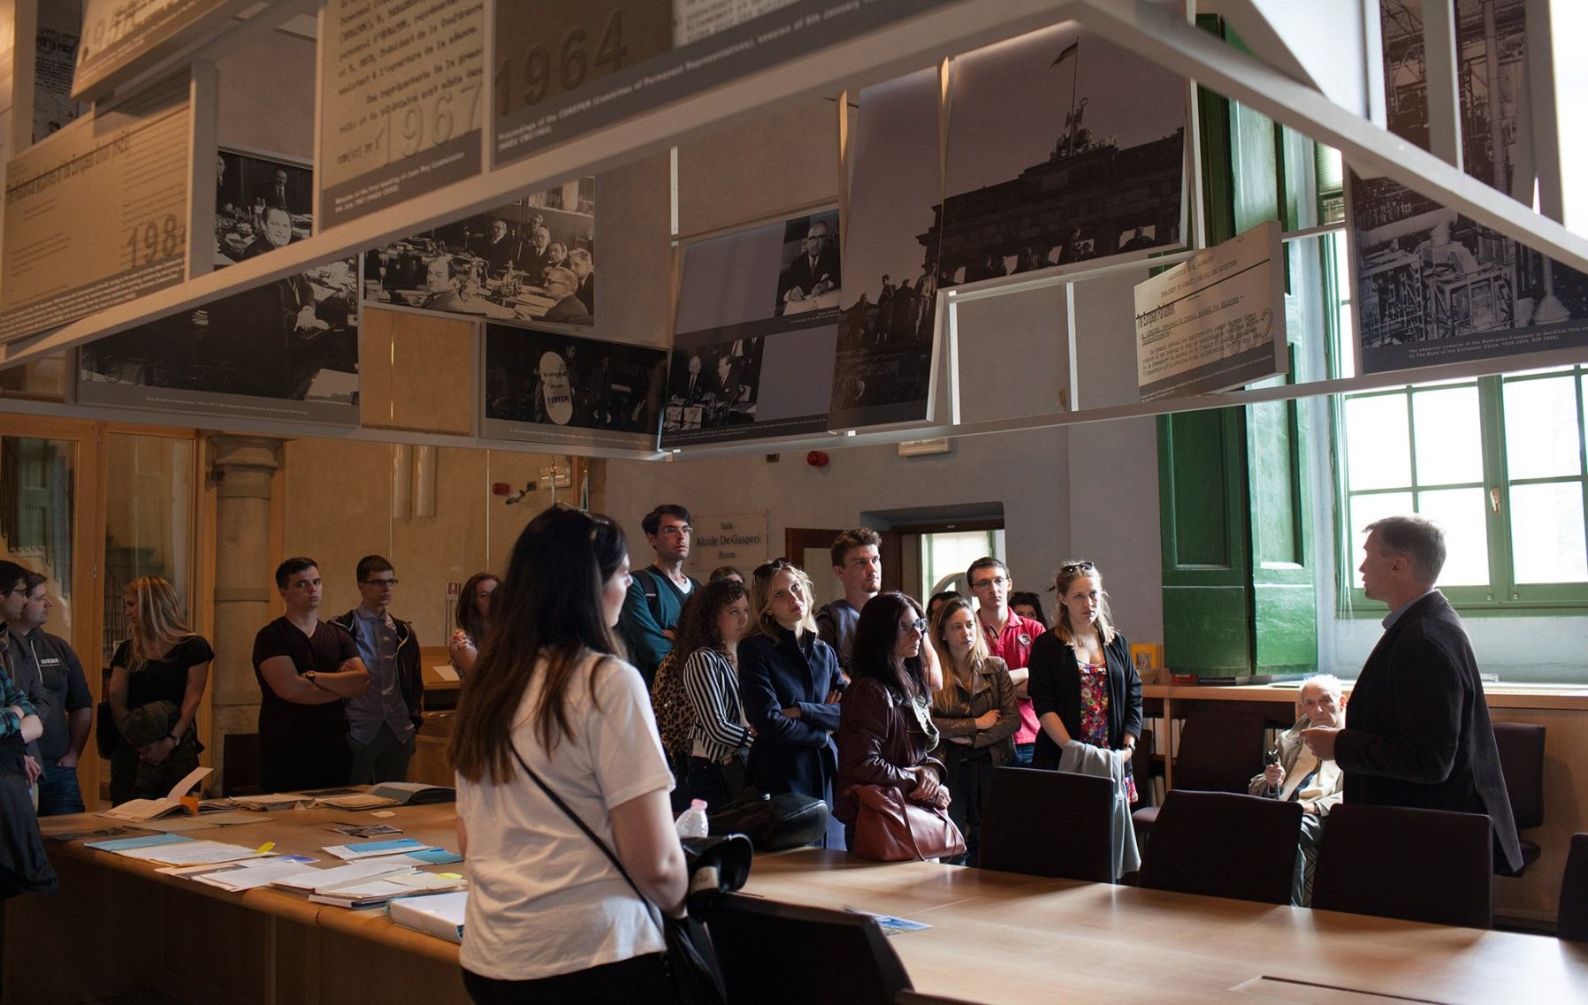

Slide 8
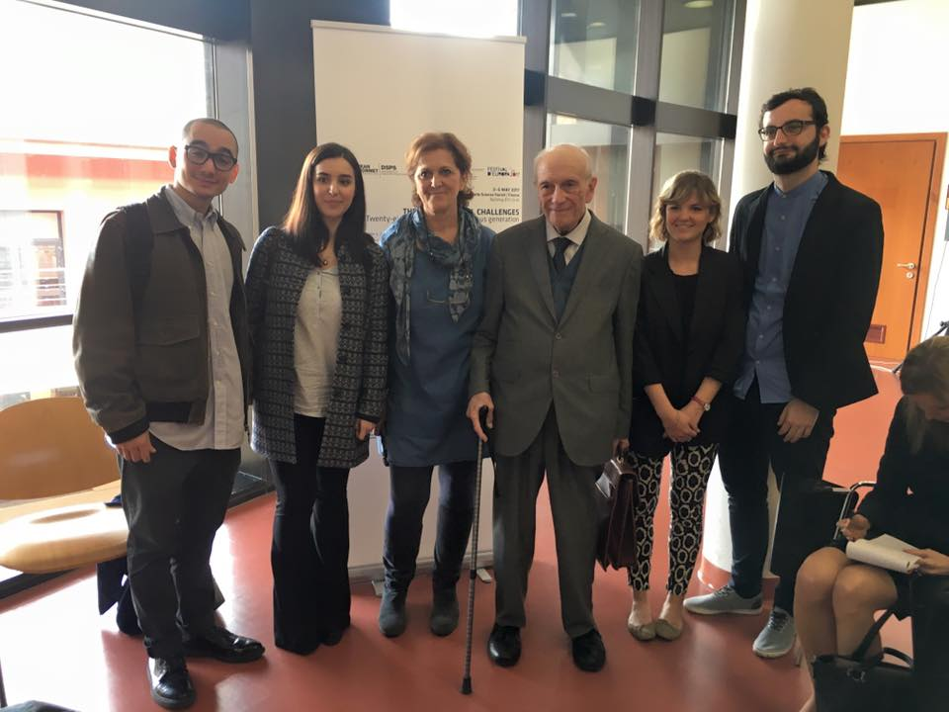

Slide 9
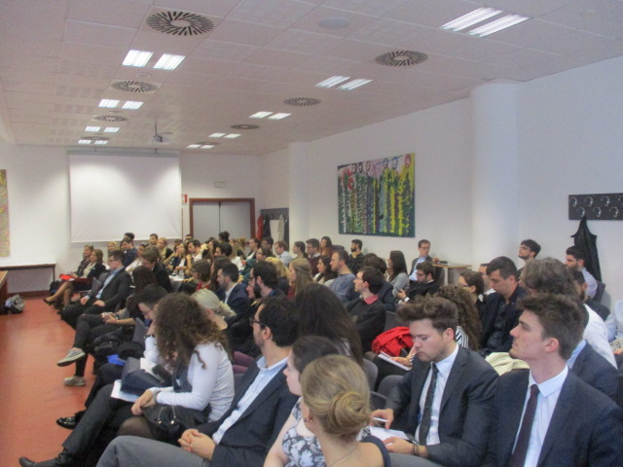

Slide 10
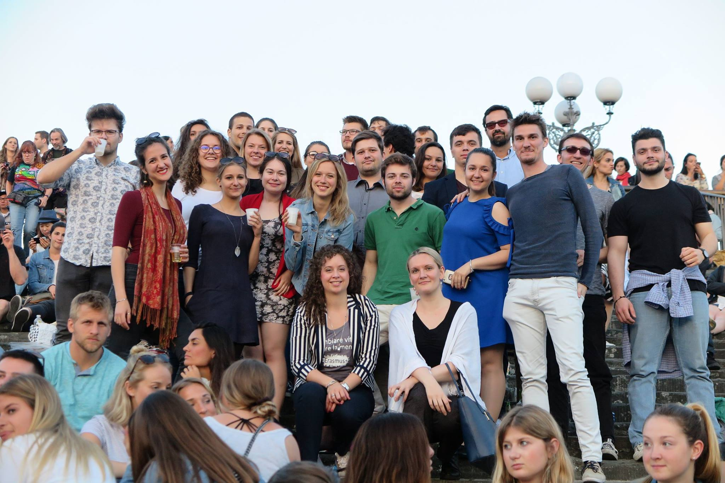

Slide 11
The Sessions
Session 1: "Shared values and rising nationalism in the EU: a difficult fit“
Session 2: "Migration, borders and frontiers"
Session 3: "The EU entrapped between enlargement and disintegration”
Session 4: "Populism, Euroscepticism and the democratic deficit: filling the gap between the EU and its citizens”
Session 5: "The EU and member states in global affairs: addressing future challenges”
Session 6: "The EU between austerity and solidarity: balancing economic and social integration"

Slide 13
An alternative to shared values or a common identity as a force of political cohesion in the EU is the concept of solidarity [...]
the type of solidarity this paper advocates is not to be confused with charity or economic assistance. [...]

Slide 14
It derives its cohesive effect from an awareness of common interests that breeds an ethically motivated willingness to build a common future.
Instead of divisiveness inherent in the idea of cultural identity solidarity minimizes differences to focus on commonalities thus breeding an attitude of tolerance and overarching cooperation.

Slide 15
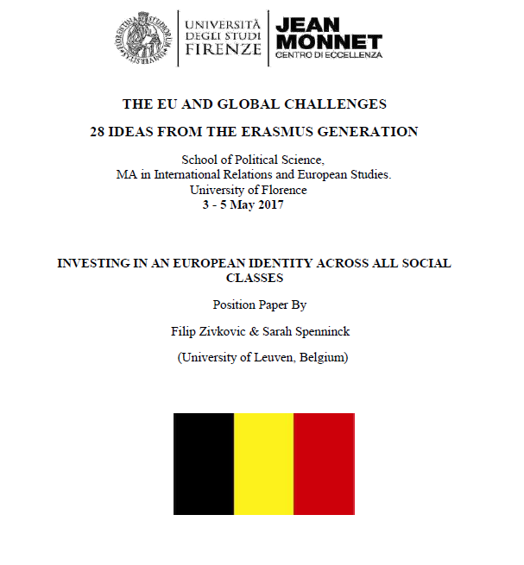

Slide 16
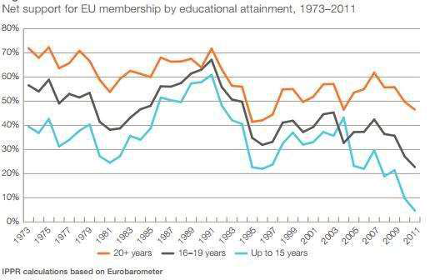

Slide 18
The project of a European TV channel aims at bringing together the different cultures of the various member states but also the varying mindsets and values of their citizens . It has as its goal a closer union where people know and respect each other.

Slide 19
MEPs and Representatives of EU institutions attending the conference
Federica Mogherini, High Representative of the Union for Foreign Affairs and Security Policy / Vice-President of the Commission;
Mercedes Bresso, Simona Bonafé, Robero Gualtieri, MEPs; Monica Frassoni, European Green Party Co-Chair;
Silvio Gonzato, Director for Strategic Communications, Parliamentary and Legal Affairs at the European External Action Service (EEAS);
Antonia Carparelli, European Commission Senior Advisor;
Miguel Maduro, former Advocate General at the European Court of Justice;
Antonio Tajani, President of the European Parliament.

Slide 20
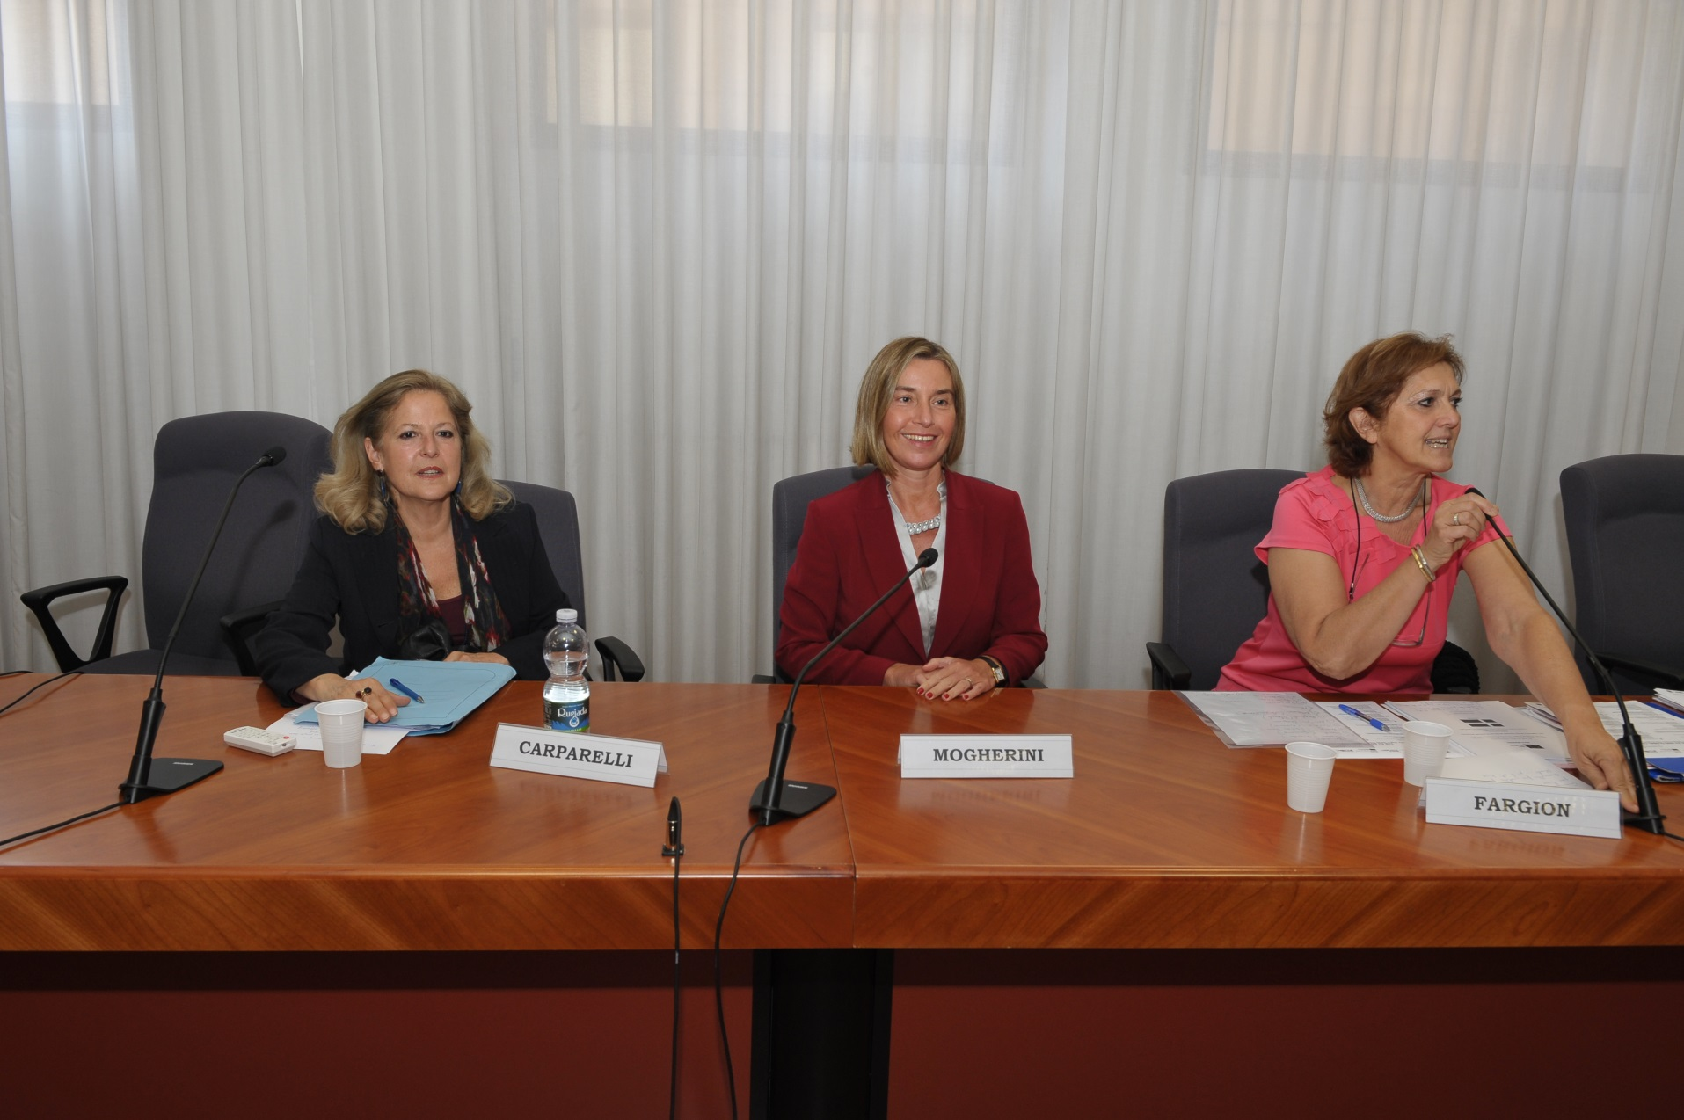

Slide 21
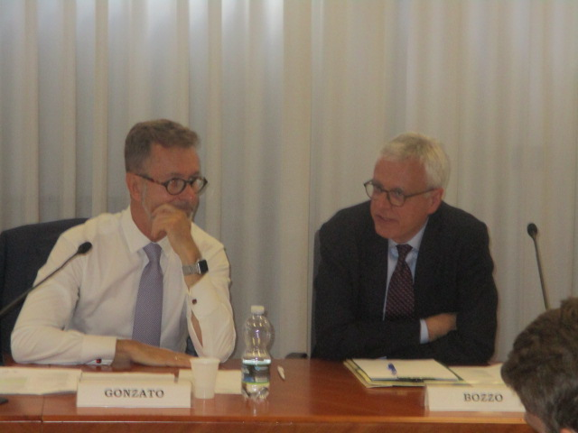

Slide 22
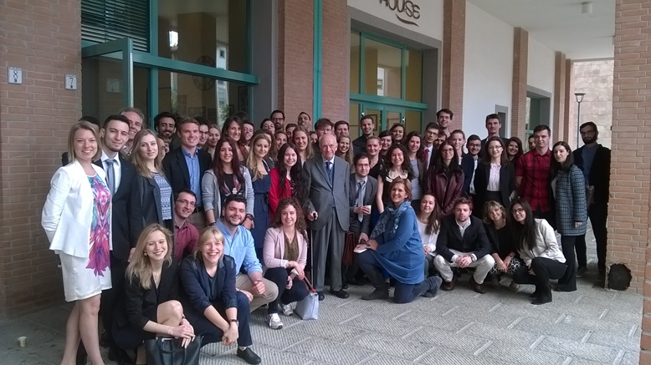
Thanks for your attention!

