Slide 1
Constitutional Acceleration in Europe
Paul blokker
University of Bologna
22 May, 2019

Slide 2
Outline 1. Contemporary challenges to constitutional democracy 2. Backcloth: Constitutional order of the EU 3. Constitutionalization in member states 4. Constitutional crisis in the EU 5. Populist critique of legal constitutionalism
Constitutional Acceleration

Slide 3
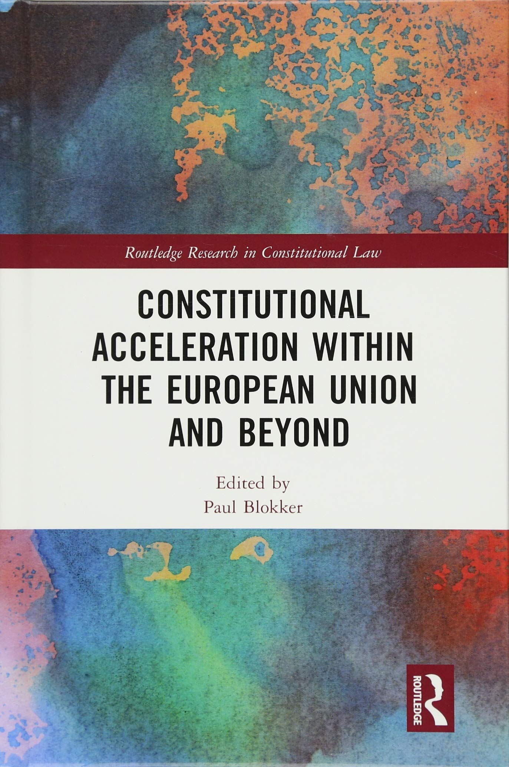
1. Challenges to constitutional democracy - Complex changes affect national or domestic constitutions - Constitutionalists currently experience a ‘situation of inquietude, determined by an insecurity with regard to their self-identity, and by the perception of an ever larger gap that separates traditional knowledge - necessary to interpret and hence represent the world - from the reality of the represented’ (Azzariti 2013)
Constitutional Acceleration

Slide 4
1. Challenges to constitutional democracy - A set of challenges informs what appears as a general tendency in domestic contexts towards ‘constitutional acceleration’; constitutional acceleration: the increased propensity of different actors to engage in (formal) reform of the constitutional order (Palermo 2007)
Constitutional Acceleration

Slide 5
1. Challenges to constitutional democracy Key reasons/motivations for change include: 1. economic reasons, related to the recent economic crisis; 2. reasons of modernization, obsoleteness; 3. reasons of redefinition of political units, in particular due to calls for extensive autonomy of distinctive regions; 4. reasons of identity and national self-rule; 5. reasons of participation and popular sovereignty, calls for more robust participation; 6. reasons of post-sovereignty, adaptation of constitutions to realities of shared sovereignty; 7. reasons of contestation of liberal constitutional democracy.
Constitutional Acceleration

Slide 6
2. Backcloth: Constitutional order of the EU - The current ‘backlash’ against legal constitutionalism (independent courts) and the rule-of-law in some countries (notably, Poland, Hungary, Romania, Czech Republic?), but to different extents elsewhere too) needs to be understood against the backcloth of the European constitutional order: a. Constitutionalization of the EU itself; b. Constitutionalization in member-states
Constitutional Acceleration

Slide 7
2. Backcloth: Constitutional order of the EU - European legal integration has been portrayed by some scholars as a complex, pluralistic process (cf. Brunkhorst; Tuori) - Initially, the European ‘integration method’, based on technocracy and ‘managerial problem-solving’, consisted in ‘functional integration of sectors such as agrarian policies or external trade and environmental protection whose regulation is administered by a small bureaucracy’ (Möller 2015: 233)
Constitutional Acceleration

Slide 8
2. Backcloth: Constitutional order of the EU - From the 1960s and 70s onwards, juridical as well as political constitutionalization processes became visible, not least as a result of judicial activism by the supranational European Court (Brunkhorst 2016: 693-95);
Constitutional Acceleration

Slide 9
2. Backcloth: Constitutional order of the EU - The strengthening of the European Convention on Human Rights (ECHR) by the 1990s could be equally understood as part of a pan-European constitutional order. - The latter is by many observers understood as the most successful human rights system in the world, and the accession of post-communist countries to the ECHR is often understood as a highly significant dimension in their democratizing trajectories. - Equally important is the so-called Venice Commission or European Commission for Democracy through Law, which was originally established to assist the post-communist countries in the early 1990s.
Constitutional Acceleration

Slide 10
3. Constitutionalization in member states - The post-1989 ‘return’ to constitutionalism and the rule of law or, at the very least, the rejection of the communist instrumentalization of the law for political purposes, reconnected with a trend of globally emerging, ‘new’ constitutionalism.
Constitutional Acceleration

Slide 11
3. Constitutionalization in member states - What makes ‘new constitutionalism’ relevant in the post-communist situation includes, among others, the following dimensions: - the (re-)establishment of sovereign, democratic orders grounded in the rule of law, - the idea of constitutional law as a higher law (and thus particularly entrenched against the influence from politics), the idea of fundamental rights, and - the idea of a guardian of the constitution in the form of a constitutional court.
Constitutional Acceleration

Slide 12
3. Constitutionalization in member states - ‘New constitutionalism’ provides one possible way of protecting societies from succumbing to totalitarianism and dictatorship. - The emphasis is on written constitutions with an entrenched 'catalogue of rights’, and a ‘system of constitutional justice to defend those rights' . The constitutional court plays a primary role in the protection of society in that it is an independent institution, which is not only regarded the ultimate guardian and interpreter of the constitution, but equally so of fundamental rights.
Constitutional Acceleration

Slide 13
4. Crisis of constitutional democracy - The most striking developments in recent years concern dramatic and rather systematic turns away from the construction of ‘new constitutionalism’ by some New Member States, and deviation from the principles of the rule of law, human rights, and democracy as enshrined in Article 2 (TEU).
Constitutional Acceleration

Slide 14
4. Crisis of constitutional democracy - Among the most significant challenges to EU law are then the profound political, legal, and constitutional changes in countries such as Hungary, Poland, Romania, and Czechia (?). - Hungary clearly started ‘deviating’ with the adoption of the new Fundamental Law in 2011. Since 2015, Poland has developed a not dissimilar trajectory, in terms of deviating from the rule of law and democracy, in, first, a political assault of the Polish government on the Constitutional Tribunal and now including the ordinary judiciary.
Constitutional Acceleration

Slide 15
5. Populist constitutional mindset 1. The rise of “populism” and “populist constitutionalism (in both East and West): a radically different “mindset” towards the law and constitutionalism 2. Dual populist critique: 1. On the European constitutional constellation: as undermining national sovereignty, undermining democracy; 2. On ‘new constitutional’ model: rule of the law, legal fundamentalism, ‘legal impossibilism’
Populist constitutionalism

Slide 16
5. Populist constitutional mindset The current populist backlash prominently includes the rejection of the distinctive post-1989 trajectory of legal constitutionalism, in terms of a liberal understanding of the rule of law, and the distinctive legal-constitutional design of constitutional democracy. In some countries, this means in practice an outright assault on the legal-constitutional order. A prominent ingredient of the populist political programs is counter-constitutional reform or even complete overhaul of the constitutional order.
Populist constitutionalism

Slide 17
5. Populist constitutional mindset What are the legal and constitutional attitudes of the populists? Three dimensions of populist attitudes (‘legal resentment’): a. Rule of law – apolitical, neutral nature of the law; b. Locus of sovereignty – sovereignty of the law; c. External meddling – external interference in domestic matters.
Populist constitutionalism

Slide 18
5. Populist constitutional mindset a. Rule of law – apolitical, neutral nature of the law; Populists criticize the liberal understanding of the rule of law and its emphasis on the apolitical, neutral nature of the law; Populists understand the constitution as always already political, and want to make its political nature explicit; The political constitution according to populists need to reflect collectivist, traditional, and Christian values explicitly, expressing the national interest and uniqueness of the political community;
Populist constitutionalism

Slide 19
5. Populist constitutional mindset a. Rule of law – apolitical, neutral nature of the law; The populist view of the political nature of the law is clearly expressed by the Senior Marshall of the Polish lower house, the Sejm, Kornel Morawiecki: The law is important but the law is not sanctity! Above the law there is the interest of the nation! If the law disturbs [sic!] this interest, it cannot be considered something which cannot be infringed, which cannot be changed! The law must serve our interest, the law which does not serve the interest of the nation is not law!
Populist constitutionalism

Slide 20
5. Populist constitutional mindset
Populist constitutionalism

Slide 21
5. Populist constitutional mindset a. Rule of law – apolitical, neutral nature of the law; A critique on ‘legal fundamentalism’ could be understood as a distinctive part of the rule of law critique: - majority/government hindered by legal constraints (‘legal impossibilism’) - state administration blocked by excessive rules and formalism (necessity of ‘legal basis’) - protection of wrongdoers by means of the law (transitional justice) - prioritization of abstract law over local mores - jurisgenerative actions by courts - excessive penetration of law into society
Populist constitutionalism

Slide 22
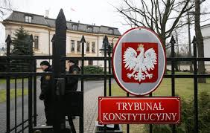
5. Populist constitutional mindset b. Locus of sovereignty – sovereignty of the law; In liberal understandings of democracy, sovereignty is related to the state, and located in the legal system. In contrast, populists situate sovereignty squarely in the ‘nation’ or the People; Populists seek to regain political sovereignty, and in order to do so, need to overcome the (‘excessive’) restrictions and limitations of the liberal rule of law, and rebalance political and judicial power; In the right-wing populist projects, this retrieval of popular sovereignty is achieved through the recentralization of power and the partisan politicization of institutions.
Populist constitutionalism

Slide 23
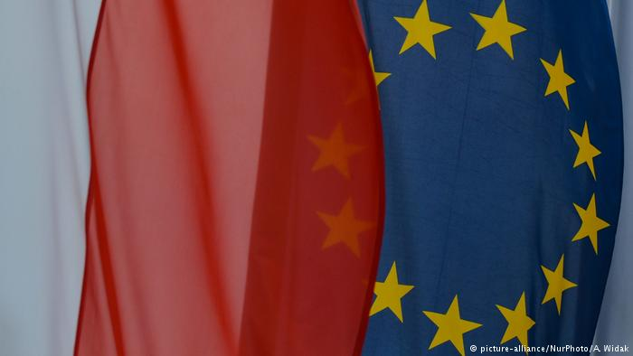
5. Populist constitutional mindset c. External meddling – external interference in domestic matters; Populists criticize any external meddling into domestic legal affairs. They use a number of arguments to do so: 1. The populists refer to classical sovereignty and the right to self-government (inter alia invoking the idea of constitutional identity and ‘unity in diversity’), 2. They criticize the incomplete and biased knowledge of foreign, international actors regarding domestic matters 3. According to populists, double standards are applied; 4. Populists question the universal validity of the liberal idea of the rule of law. ;
Populist constitutionalism

