Slide 1



Plurilingualism and Europe’s future
Jessica A. Thonn
Centro Linguistico di Ateneo
Citizenship, identity and solidarity in Europe lecture series
April 24, 2018

Slide 2
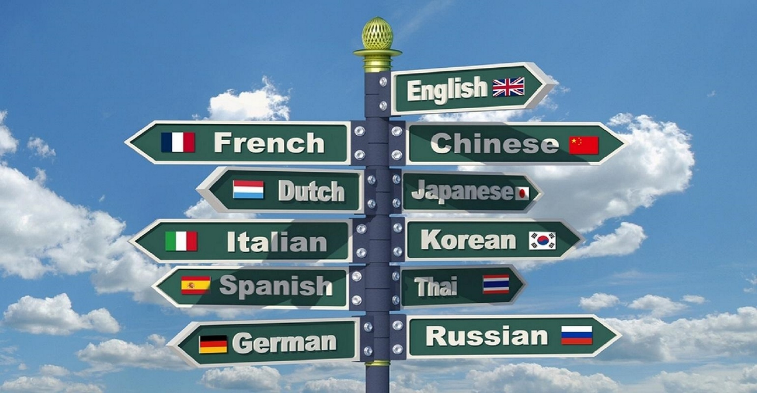



Plurilingualism and Europe’s future – Jessica A. Thonn – April 24, 2018
EU Regulations
Education
#s & Stats
Language dominance
Attitudes
Past and present EU plurilingualism
Current trends and hot topics
Speculating about the future

Slide 3


Plurilingualism and Europe’s future – Jessica A. Thonn – April 24, 2018

Slide 4

Past EU regulations
Plurilingualism and Europe’s future – Jessica A. Thonn – April 24, 2018
1984 EU recommends
1995 EU Council resolves
2002 - Barcelona policy - calls for action
2008 – Lisbon policy - invites
Go to www.menti.com
and type the code 54 10 80

Slide 5

EU #s http:// ec.europe.eu/education/policy/multilingualism/linguistic-diversity_en
500 million citizens
28 member states
3 alphabets
24 official languages
60 other languages
Go to www.menti.com
and type the code 78 07 56

Slide 6
EU #s
Europeans and their languages, Special Eurobarometer 386 (2012)
Plurilingualism and Europe’s future – Jessica A. Thonn – April 24, 2018

Slide 7
Who speaks L1 & L2?
Plurilingualism and Europe’s future – Jessica A. Thonn – April 24, 2018
Luxembourg | 98%
Latvia | 95%
The Netherlands | 94%
Malta | 93%
Slovenia & Lithuania | 92%
Sweden | 91%
Hungary | 65%
Italy | 62%
The UK & Portugal | 61%
Ireland | 60%

Slide 8
«Every citizen should have practical skills in at least 2 foreign languages»
Plurilingualism and Europe’s future – Jessica A. Thonn – April 24, 2018

Slide 9
Present EU regulations
Plurilingualism and Europe’s future – Jessica A. Thonn – April 24, 2018
Lisbon policy
«… to broaden the selection of languages taught at different levels of education – including recognised languages which are less widely used, so as to enable pupils to choose on the basis of considerations such as personal interests or geographical situation.»
Council Resolution (2008)
Current trends
less widely used
enable pupils to choose
geographical situation

Slide 10


Plurilingualism in Education in Italy
Plurilingualism and Europe’s future – Jessica A. Thonn – April 24, 2018
CLIL
2000
2003
Content and
Language
Integrated in
Learning
2010
2014
2015

Slide 11

Plurilingualism in Education in Italy
Plurilingualism and Europe’s future – Jessica A. Thonn – April 24, 2018
EMI
English
Mediated
Instruction
English as a
Medium of
Instruction

Slide 12
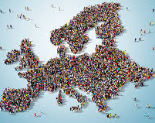
Attitudes towards plurilingualism
Europeans and their languages, Special Eurobarometer 386 (2012)
Plurilingualism and Europe’s future – Jessica A. Thonn – April 24, 2018
«Everyone should be able to speak at least one foreign language»
«All languages should be treated equally»
«Everyone should be able to speak more than one foreign language»
81%
84%
72%
«EU institutions should adopt a single language»
53%

Slide 13
What happens to groups whose language disintegrates?
Plurilingualism and Europe’s future – Jessica A. Thonn – April 24, 2018
Why is plurilingualism important?
Higher costs for healthcare
They/we lose their literature
Go to www.menti.com
and type the code 92 22 99
They/we lose their knowledge
Higher costs for welfare
They/we lose their culture
Higher alcohol/drug usage & problems
They lose their group identity
They lose their group pride
They lose their social support network
Less able to contribute to govt & society
Source: Diamond, Jared (2012) The world until yesterday. Penguin.

Slide 14

Plurilingualism in Education in Italy
Plurilingualism and Europe’s future – Jessica A. Thonn – April 24, 2018
Source: http://www.integrazionemigranti.gov.it/Attualita/Notizie/Pagine/Alunni-con-cittadinanza-non-italiana--La-scuola-multiculturale-nei-contesti-locali.aspx

Slide 15
Foreign children in Italian schools 2014/15
(national average: 9.2%)
Plurilingualism and Europe’s future – Jessica A. Thonn – April 24, 2018

Slide 16
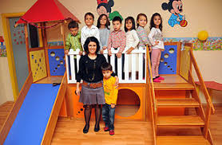

Plurilingualism in Education in Italy
Plurilingualism and Europe’s future – Jessica A. Thonn – April 24, 2018
2nd Bangladesh
2nd Albanians
Heritage language
3rd Albanians
Romanians
Nursery schools:
Bangladesh
Morocco
Egypt
Primary schools:
Bangladesh
Egypt
Pakistan
India
Middle schools:
China
Macedonia
Filippines
High schools:
Ucraine
Moldovia
Peru
Ecuador

Slide 17
Plurilingualism and Europe’s future – Jessica A. Thonn – April 24, 2018
The European situation vs Italy (Eurostat, 2014)
Percentage of immigrants with a college degree or above (15 - 64 yrs old) | UE: 25,5% Italy: 10%
Percentage of immigrants who partake in lifelong learning (15 - 64 yrs old) | UE: 15% Italy: 6%
Percentage of immigrants not engaged in education, employment or training (15 - 29 yrs old) | UE: 23% Italy: 35%
Immigrant early school leavers (18 – 24 yrs old) | UE: 23% Italy: 35%

Slide 18
Current trends
Plurilingualism and Europe’s future – Jessica A. Thonn – April 24, 2018
Minority languages/dialects
Freedom of choice
Learn your neighbors’ tongue
Intercomprehension
Languaculture
Мы вас похороним!

Slide 19

Plurilingualism and Europe’s future – Jessica A. Thonn – April 24, 2018
1519: Moteukzoma (Montezuma) and Hernan Cortes
  Enter into your palace
  You come from the clouds, the mists, a mysterious place;
  The ancient kings who in the past were guardians of your domain said you would return
  you have come to your throne, which I have briefly kept for you.
  It is not just a fantasy, just a dream; I am not dreaming, not fantasising; for I have seen you, I have looked upon you

Slide 20
Wrapping things up…
Plurilingualism and Europe’s future – Jessica A. Thonn – April 24, 2018
Past and present EU plurilingualism
Current trends and hot topics
Speculating about the future

