Slide 1

The EU’s strategic agenda 2019-2024 A European Commission contribution
Shared Values and Global Challenges. Ideas for a New Renaissance of Europe
Florence, 22-23 May 2019
Antonia Carparelli – European Commission

Slide 2
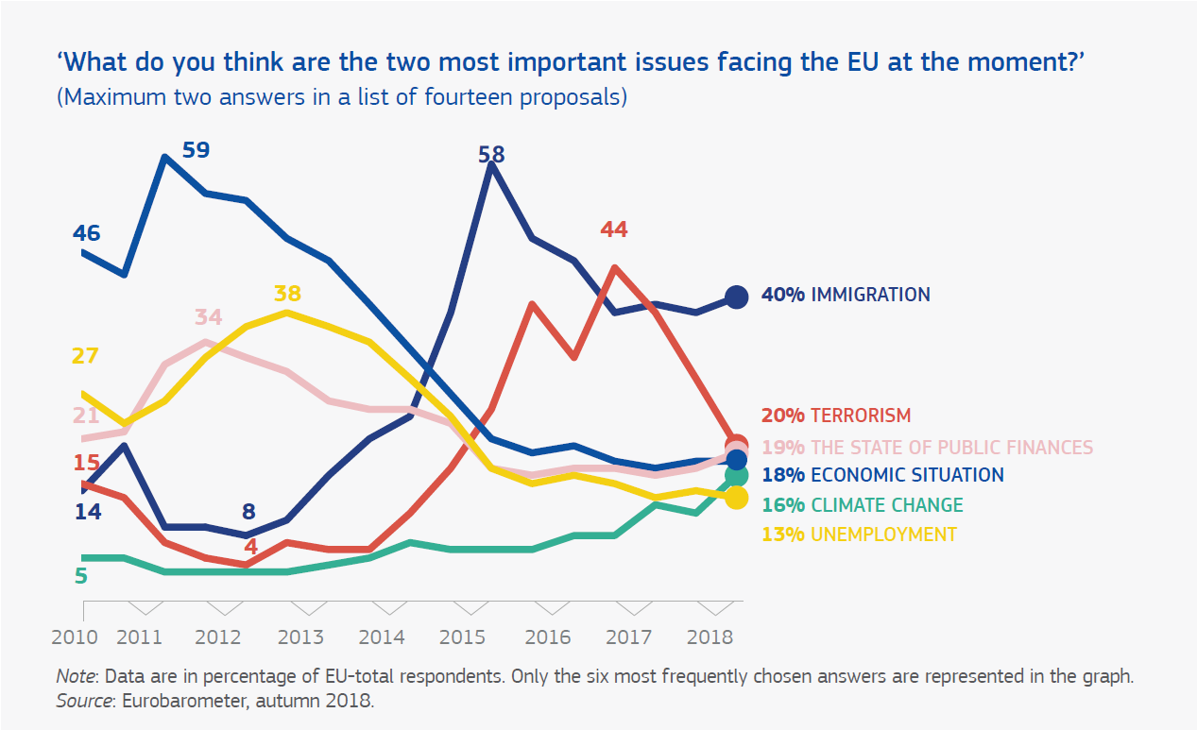
EU citizens’ concerns and priorities

Slide 3
Five Recommendations to future EU leaders
Protective Europe
Competitive Europe
Fair Europe
Sustainable Europe
Influential Europe

Slide 4
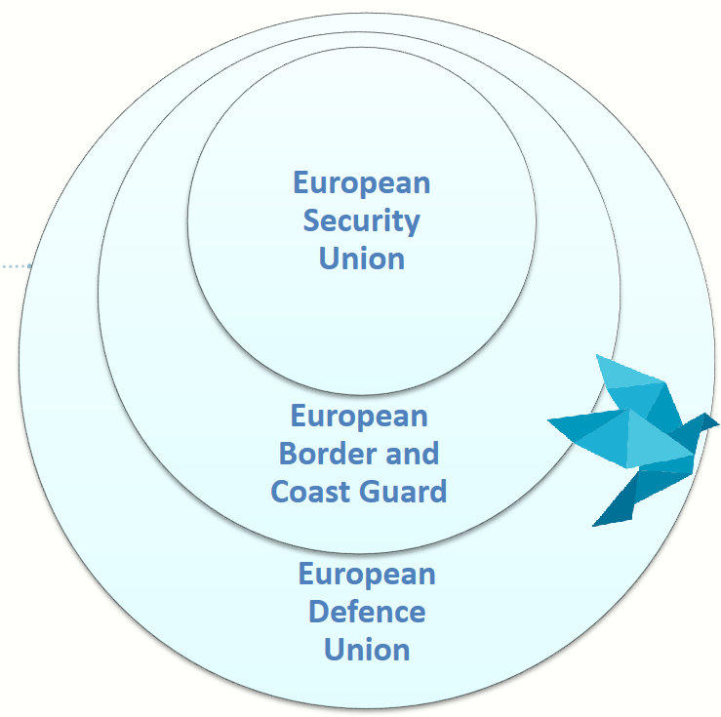
Protective Europe
European Defence Union
Immigration, terrorism and security are top concerns for EU citizens.
The EU should become more protective inside, outside and along European borders.
European Border and Coast Guard
European Security Union

Slide 5
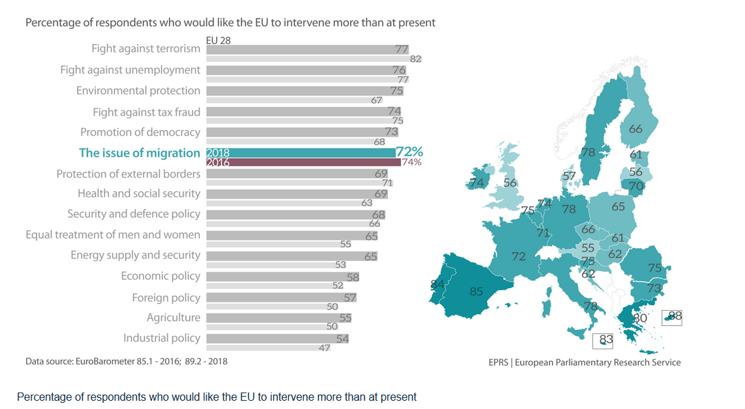
Migration as a EU challenge
https://epthinktank.eu/2019/03/21/eu-policies-delivering-for-citizens-the-migration-issue-policy-podcast/04_migration_bar-chart_map_gw/

Slide 6
Competitive Europe
Budgetary Instrument for convergence and competitiveness
European Safe Assets
Cleaner and more automated Single European Transport Area
European-made and human-centric artificial intelligence
Funding research and innovation
Deepening the Economic and Monetary Union

Slide 7
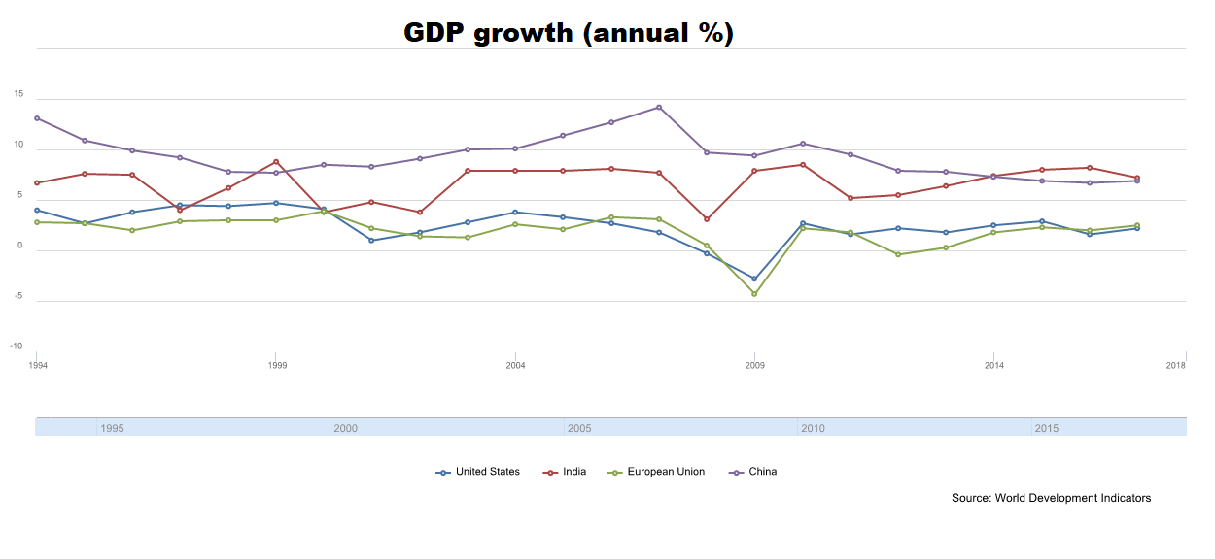
GDP growth in Europe, US, China and India

Slide 8
Fair Europe
Deliver on the European Pillar of Social Rights
Social inclusion and equality policies
The rule of law
Fundamental rights in the digital world
Fair and modern taxation policy
Emproving health care
Quality, energy-efficient affordable housing

Slide 9


Slide 10
Sustainable Europe
Further implementation
2030 Agenda for Sustainable Development
25% of 2021-2027 MFF for investments on climate action
rescEU
Circular Economy action plan
Wiser energy taxation

Slide 11
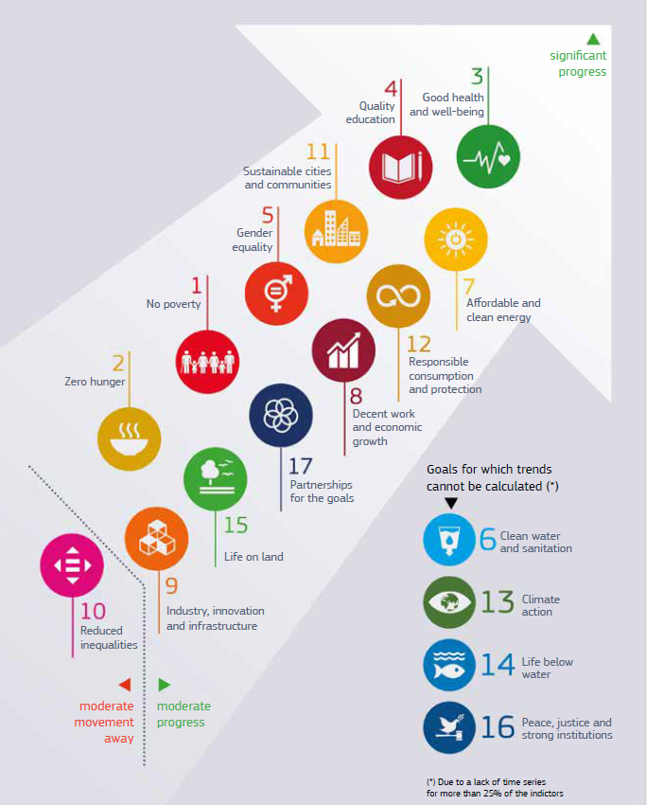

Slide 12
Influential Europe
Supporting multilateral, rules-based global order (UN)
Preserving multilateral trading system (WTO)
Strengthening the international role of Euro
Developing strong relations with close neighbours
The EU should promote global governance based on the core values of human rights, rule of law, sustainable development, multilateralism and the respect for international humanitarian law.
An open and fair trade agenda creates opportunities for European citizens and businesses while ensuring a level playing field at home and abroad.
A strengthened international role of the euro would increase Europe’s economic and monetary sovereignty, lowering costs and risk of trading internationally and contributing to greater financial stability.
Africa-Europe Alliance for Sustainable Investment and Jobs
NDICI (Neighbourhood, Development, and International Cooperation Instrument)
Transformation of the Western Balkans through a credible enlargement policy

Slide 13
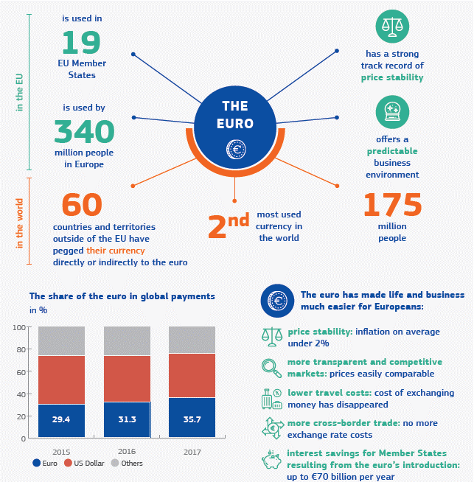


Slide 14
Thanks for your attention!
Antonia.Carparelli@ec.europa.eu

