Slide 1
Workshop The linguistic future of the EU: A political choice
26 April 2018 Prof. Nicholas Brownlees
The role of English in the future EU

Slide 2
English as global language: Kachru’s 3 circles

Slide 3
English easy to learn?
Four levels of language
Grammar/syntax
Semantics
Morphology
Phonology
All easy to use? If so, why?

Slide 4
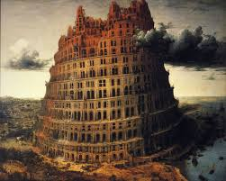
Increased use of English has helped to unify Europe?
Can the common use of one language unify countries? If so, why?

Slide 5
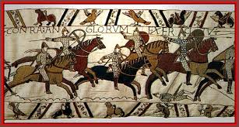
But what happens if the common language is the language of victors?

Slide 6
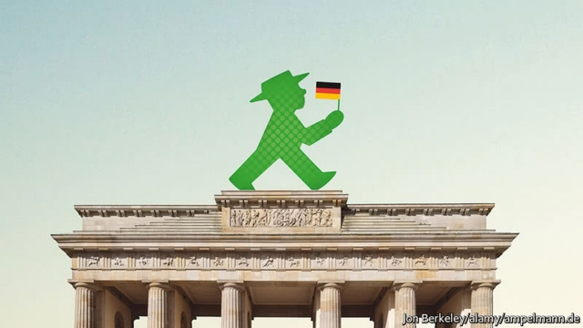
Will young people lose interest in learning English after Brexit?
London and English still cool? Or are Berlin and German the hippest?

Slide 7
After Brexit English will continue as a working language in the EU parliament
Now EU policy documents published in parallel in 24 languages but top three languages (English, French, German) relates to their use as procedural languages for the weekly meetings of the 28 commissioners

Slide 8
After Brexit English will continue as a working language in the EU parliament
«the English language no longer has any legitimacy in Brussels» (Robert Menard)
«English can no longer be the third working language in the European Parliament» (Jean Luc Melenchon)
Which member states speak English?
Which are the official languages of :
Ireland?
Malta?
But …..

Slide 9
… support for English too
«change to the EU Institutions’ language regime is subject to a unanimous vote of the Council, including Ireland»
(official statement of Republic of Ireland)
…. And could English become more useful as a neutral language now that it is no longer associated with a leading EU state?

Slide 10
Mario Monti: EU should adopt English post Brexit
Ex-Italian PM says the EU should ‘take the decision of upgrading the use of the English language in European Union affairs.’
Mario Monti, the former Italian prime minister and European commissioner, said English should become the main official language of the European Union, once the U.K. leaves the bloc.
“I think we should upgrade the ways we use English and it should become the language of the European Union. I exaggerate a bit — there should be a bit of French. It will be a very appropriate gesture to the U.K. It would help us Europeans to become more competitive by using fewer languages.”
www.politico.eu/article/brexit-mario-monti-eu-should-adopt-english

Slide 11
If English is still used, will British English be a model for EU proceedings in English?
Who will be deciding the model or perhaps there will be no model? For example, in the EU parliament British English will never be heard
Will the Irish support the use of British English?
Will American spelling be considered more useful?
Will there be some form of ‘Euro-English’?

Slide 12
Future reading
World Englishes, 2017
(can be downloaded from University library resources)

