Slide 1
Conflitti di valore in un’Europa differenziata. L’impatto dei media digitali sulla polarizzazione dei valori in Europa Value conflicts in a differentiated Europe. The impact of digital media on value polarisation in Europe
Hans-Jörg Trenz,
University of Copenhagen

Slide 2
The idea of ‘shared values’ and European integration
The European Union's fundamental values are respect for human dignity and human rights, freedom, democracy, equality and the rule of law. ... The main goal of the European Union is to defend these values in Europe and promote peace and the wellbeing of the citizens.
Art. 3 TEU)
The value-based foundations of European integration (historical roots of shared values, Europe as a value community or civilisation)
The idea that European integration leads to the consolidation of shared values (integration as a measurement of value convergence over time )

Slide 3
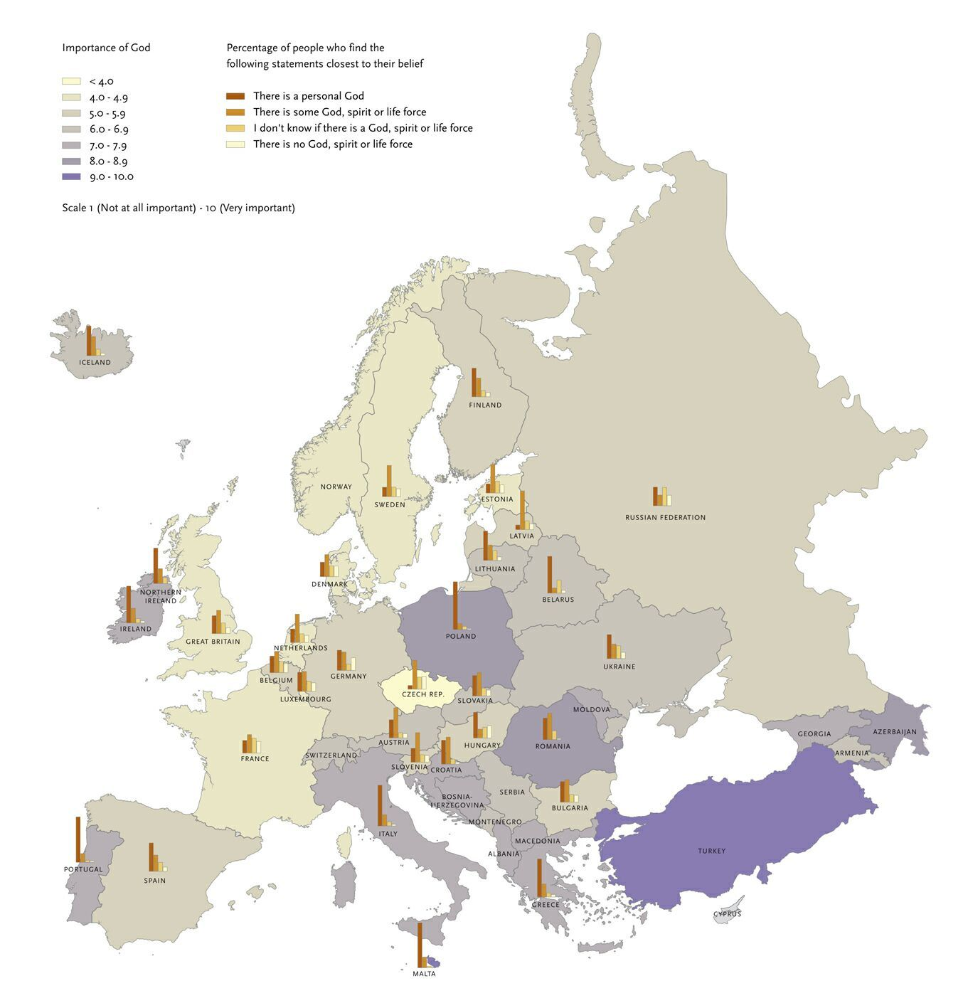
From ‘shared values’ to value differentiation
The conspicipus absence of a convergence of values
Value diversity between European societies is not diminuishing but lasting and possibly increasing

Slide 4
The new right and ‘shared values’

Slide 5
But: the divided new right
The ‘new right’ is rather divided than united by values
Clusters of Right-Wing Populism (Brubaker 2017):
national populists in Northern and Western Europe: are liberals, or some would say even ultraliberals and defend secular values
Central and Eastern European national populism: are illiberal and religious
American populism (Trumpism and Bolsonaro): are often sectarian, radical like Tea party movement or new religious sects in Latin America, they are certainly illiberal but often also propagating alternative nationalism

Slide 6
From value community to value pluralism and conflicts of values
Values not a ‘sacred’ or as ‘universals’ that are placed outside the realm of political conflict
The validity of values remains contested
From the essence of values to the process of validation
-> democracy as a form of value contestation in the public sphere (Öffentlichkeit)

Slide 7
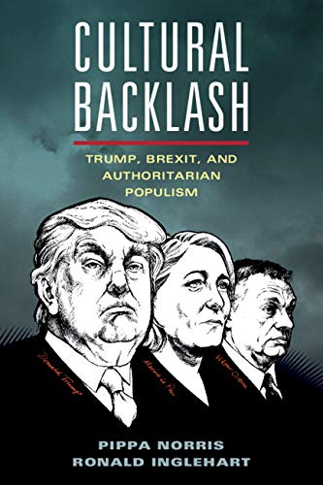
‘New’ and ‘enhanced’ value conflicts in the EU?
Cultural backlash and new cleavages:
Internal (domestic): primordial against cosmopolitan
Transnational (European): Old vs new Europe, East-West, North-South divides

Slide 8
What is new with the ‘new’ value conflicts?
The Media and communicative dynamics of value contestation
emergence of value conflicts and new social cleavages as facilitated by the new digital media
The linkage between value conflicts and new social media communications
-> a transformation of media and communicative infrastructure that drive value contestation, nationally and transnationally

Slide 10
User and Media driven dynamics of value contestation

Slide 11
Disruptive public spheres
Value contestation in relation to public sphere fragmentation:
disruption, disconnection and dissonance
Polarisation and radicalisation
Hostility towards each other’s views, beliefs and conduct,
Belief that the interests of different groups or the values these groups hold cannot be reconciled
Polarisation as a constructed media phenomenon
Fake divides
Struggle over silent majorities

Slide 12
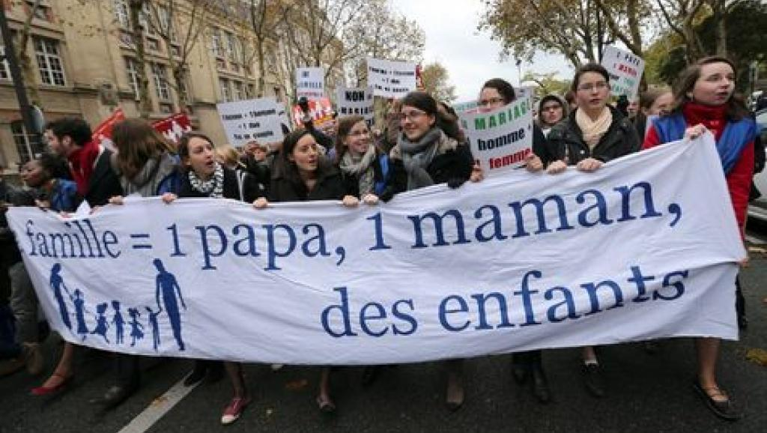
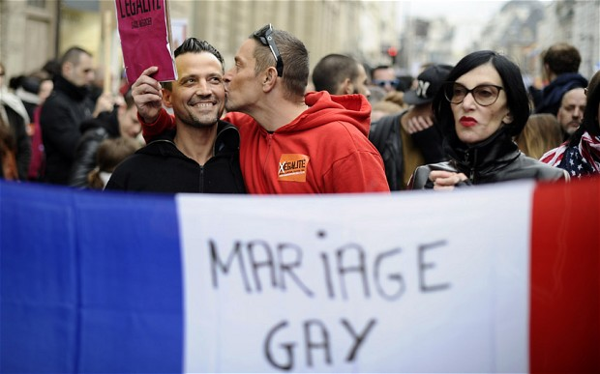
Polarisation
deeper divisions between social groups within societies
Deeper divisions between European societies
domestic polarization is often framed in cultural terms: people who espouse cosmopolitan values against people who espouse traditional cultural and nationalist values
Transnational polairsation is often redistributive: states which profit from market liberalisation and states which fall behind

Slide 13
Media and public sphere transformations
The decline of news consumption: the number of news readers is dramatically shrinking
The tabloidisation of news: quality journalism does no longer deliver, decline of public service media in some European countries, from balanced to imbalanced news
Decline of trust in legacy media and journalism: we find instances of direct attacks to journalistic institutions by politicians but also public turning away from them
Decline of press freedom: direct interventions by law, dismantling of public service broadcasting
The selective exposure to news: social media become the first access point to political news, especially for young people
The selective exposure to opinion: Fringe or extreme perspectives entering mainstream debate

Slide 14
Is the Internet Eroding Europe’s Middle Ground?
Social media algorithm: prioritize specific news that triggers strong emotional reactions
Echo chambers and filter bubbles that reinforce people’s existing beliefs and reduce their exposure to opposing perspectives
Replacement of journalistic gatekeepers by political campaigners who can more easily micro-target specific audiences with misinformation or radical opinion
Fake news: extreme groups or foreign states (Russia) coordinate to target campaigns
Users’ misbehavior: hate and verbal violence towards others

Slide 15
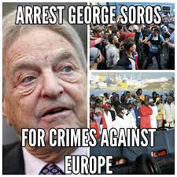
The mainstreaming of racism
The Great Replacement (Brenton Tarrant)
White supremacy in the US
Il grande genocidio (Salvini)
White genocide
defending Europe” from “invasion,”
the need for “remigration” (or, less politely, ethnic cleansing)
The anti-Soros propaganda.

Slide 16
Fragmented societies, declining democracies
Democracy under siege: recent trends towards social fracturing will continue
Social media dynamics of political communication have a potential to trigger democratic reversals in multiple countries and jeopardising the role and future of the European Union
Authoritarian populists will continue to cause major political disruptions
Far-right extremists will strengthen their ability to cooperate across Europe and refine their tactics and Strategies
Algorithm based news will continue to polarize and radicalise populations
Larger numbers of people (especially young males) will radicalise online
This will result in more frequent violent attacks and acts of terrorism targeting minorities and groups that challenge extremist organisations

Slide 17
From ‘disruptive’ to resilient public spheres
Individual rights protection: A charter that protects the rights and liberties of citizens — a Magna Carta for the digital age — is the place to start (A. Giddens)
The EU as a pioneer: Data protection and online privacy
Collective mobilisation: expression of shared concerns and identification of common good
Don’t be afraid of value conflicts!
Greta Thunberg: ‘Forget Brexit and focus on climate change’
Constructive journalism: the revival of quality news formats
Fake divides: the stuggle over silent majorities

