Slide 1
Progetto WikiEurope
Silvia Bruni
Biblioteca di Scienze sociali
23 maggio 2019

Slide 2
Wikipedia as information source
Wikipedia a non profit project, having the specific aim to spread freely the knowledge.
“Imagine a world in which every single person on the planet is given free access to the sum of all human knowledge. That's what we're doing”
(Jimmy Wales, Wikimedia founder, interviewed in 2004)

Slide 3
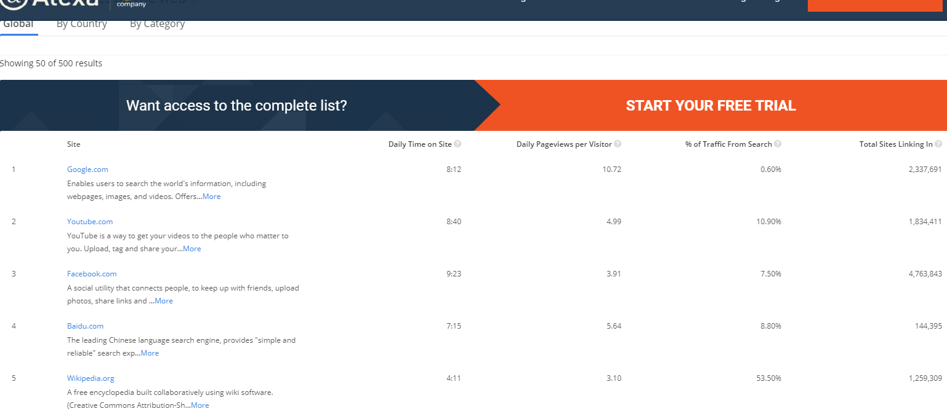
Visibility: the top 500 Websites in the world
Wikipedia It is the unique non profit project beetwen the most consulted website in the world

Slide 4
Wikipedia collaborates with institutions

Slide 5
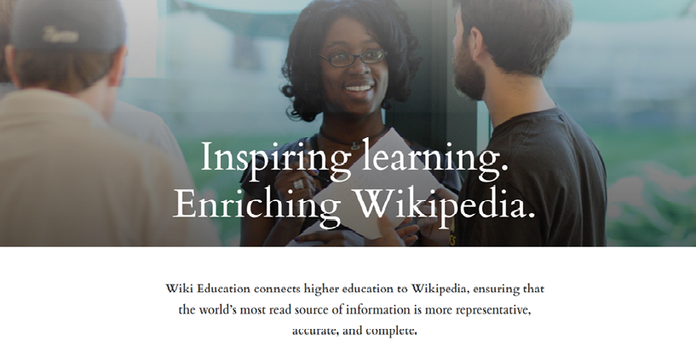
Wikipedia in learning process

Slide 6
Literature on writing in wikipedia learnings:
Practising documented writing (no original contribution)
Citing
Create access to sources
Collaborating
Discussing
Contributing in knowledge sharing («third mission» of universities)

Slide 7
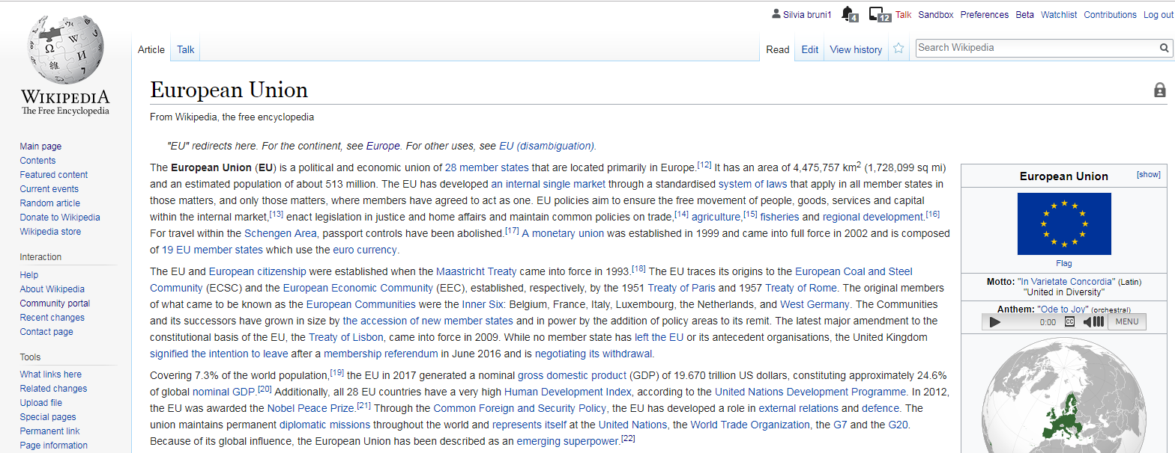

Slide 8
Citing

Slide 9
Access to go deeply

Slide 10
Collaborating

Slide 11
Discussing

Slide 12
Wikipedia in the University of Florence

Slide 13
Wikipedia in the course: Society and social change in Europe Professor: Laura Leonardi, march-may 2019
13 Erasmus Students writing Wikipedia articles
European Topics

Slide 14
Documenting the process

Slide 15
Communicating with Wikipedia community

Slide 16
Wikipedia in the course: Society and social change in Europe Professor: Laura Leonardi, march-may 2019 STEPS
Creation of the group
Presentation
Choice of documents about European integration
Conceptual map
Creation of couples
Choice of articles to write in Wikipedia.en
Searching for sources
Starting writing in sandbox pages
Revisions
Showing articles in class
Discussion

Slide 17
Last step after the conference…
PUBLICATION IN WIKIPEDIA:
The article will
be read potentially in all over the world

Slide 18
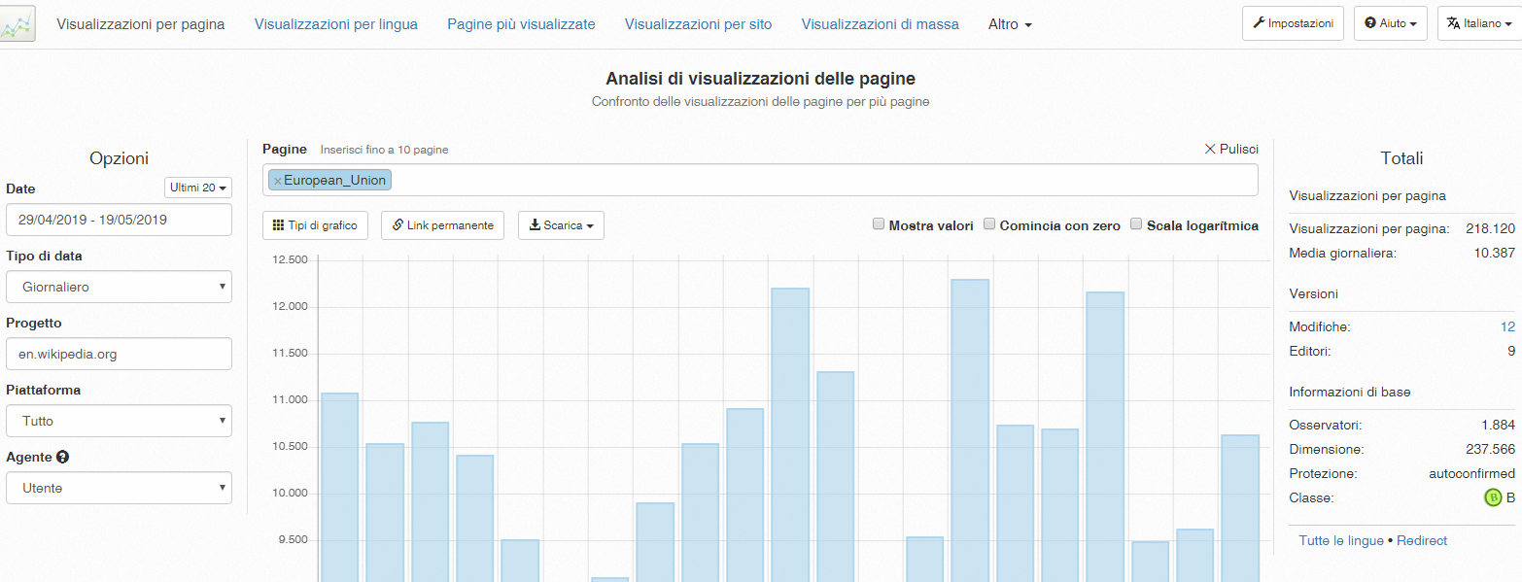

Slide 19
The protagonists…
But now…

